Slide 1

Smart Stock Inventory Optimization for Retail Stores
Prepared By- Vaishnavi Potu

Slide 2
INTRODUCTION
This project introduces a “Smart Inventory Optimization System”, a software-based AI solution that analyzes sales trends, demand patterns, supplier performance, and historical data to automatically recommend the right stock levels.
By using machine learning models, datasets from platforms like HuggingFace or Kaggle, and an intelligent dashboard, the system helps retail stores maintain optimal inventory, reduce wastage, and ensure products are always available on time. This smart approach minimizes manual work, supports decision-making, and makes inventory planning faster, more accurate, and cost-efficient.
PROBLEM STATEMENT
Retail stores face stockouts and overstocking due to inaccurate forecasting, manual monitoring, and difficulty analyzing large sales and supplier data.
Frequent Stockouts
Overstocking Issues
Inaccurate Demand Forecasting
Manual Inventory Tracking

Slide 3

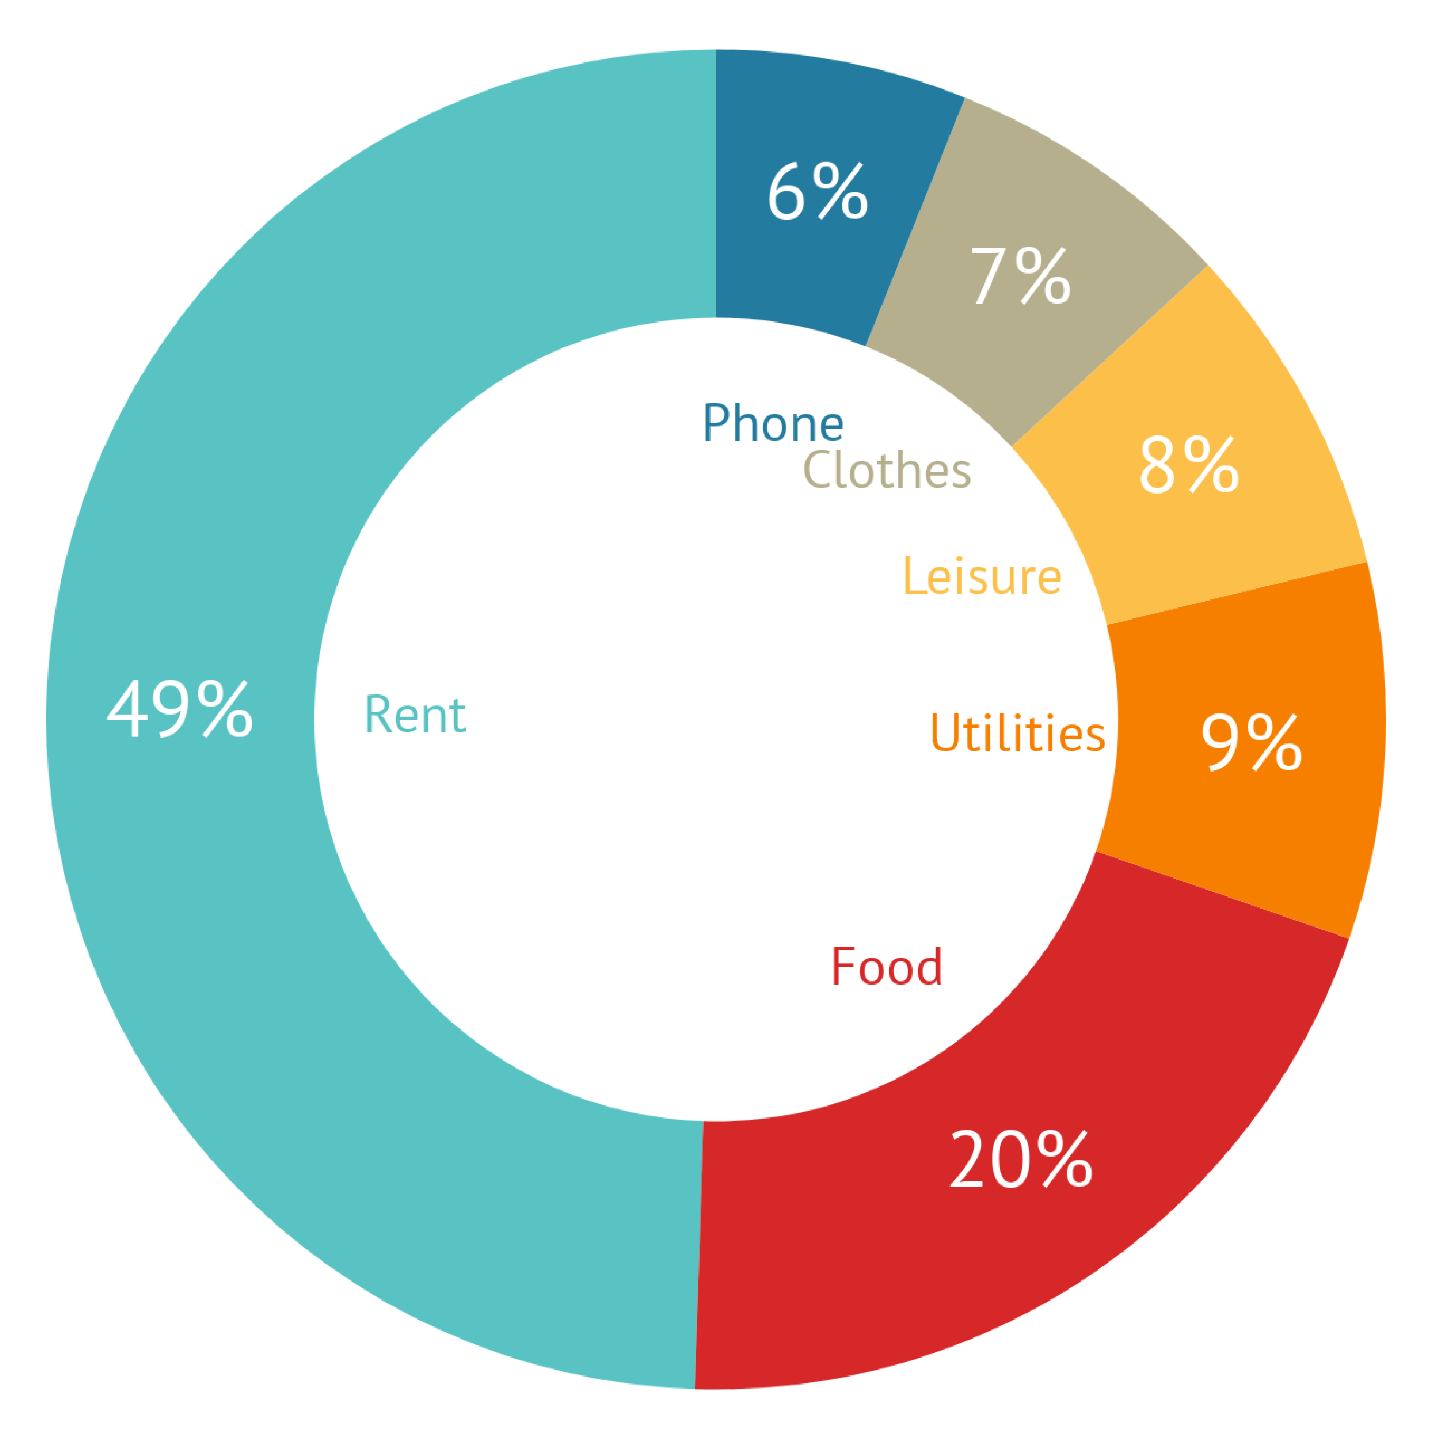
SYSTEM ARCHITECTURE
DATASET
(Retail store inventory By Kaggle)
TOOLS/ TECHNOLOGY
DATABASE
MySQL
1. Frontend- React.js/HTML/CSS
2. Backend- Python
3. Database- MySQL
4. API- Fast API
5. Dataset- Retail Store Inventory (Kaggle)
STOCK
Product Id
Product Name
Product price
Expiry date
Stock quantity
Daily sales
Weekly sales
CATEGORY
Fast selling
Slow selling
Non selling
Seasonal stock
Perishable stock
Buffer stock
Over stock
SALES
Sales Id
Product Id
Date
Units sold
Revenue
DASHBOARD
Stock Level
Overstock, Stock out, Low stock
Expiry risk Indicator
High risk, Medium risk, Low risk
Prediction
Demand, Stockout

Slide 4
BACKEND
Database- Inventory retail store
MySQL
Programming Language
Python 3.10+
Backend Framework
Fast API
Django REST Framework (DRF)
Python Libraries Needed
scikit-learn
numpy
pandas
sqlalchemy pymysql
urllib.parse
matplotlib
Server / Environment Tools
Postman
Docker
Git/GitHub
Data Visualization
Matplotlib
Seaborn
plotly

Slide 5
Creating Database
Downloaded dataset from Kaggle ( retail store inventory)
Used csv file of dataset
db- “smart_inventory”
Created tables- retail_store_inventory
Loaded csv file into db
PYTHON CONNECTOR
Installed Python packages: pandas, sqlalchemy, pymysql.
Used SQLAlchemy to connect Python to your database
Used pandas to load data in Python
Analyzed smart Inventory
Checked products with low stock
Display low stock alert
Bar Chart for Total Inventory per Store- To see how much stock each store currently has.
Bar Chart for Units Sold per Category- To identify which product categories sell the most.
Stock Level Summary Chart- To see how products are distributed by inventory level (Low, Medium, High).

Slide 6
MODEL TRAINING: Sales Prediction
Objective:
Predict future sales for each product based on historical data and inventory features.
Support inventory management decisions and reorder alerts.
1.Data Preparation:
Extracted relevant features from the database:
  product_id, category, inventory_level, units_sold, units_ordered, demand_forecast, price, discount, seasonality, etc.
2.Conversion:
Conver categorical variables if needed
Cleaned and preprocessed data for training:
Handle missing values
Split data into training and testing sets to evaluate model performance.
3. Model Selection:
Random Forest Regressor used for prediction:
  Handles non-linear relationships
  Reduces overfitting via ensemble learning
  Provides feature importance insights

Slide 7
MODEL TRAINING: Sales Prediction
4. Training Process:
Trained model on historical sales data.
Predicted future sales for each product.
Compared predictions with actual sales to evaluate accuracy.
Adjusted model parameters for better performance if needed.
5. Outcome:
Accurate predictions of future sales per product.
Supports decision-making for:
  Stock alerts
  Reorder suggestions
Ready to integrate into the Streamlit dashboard for visualization.

Slide 8
TOOLS/TECHNOLOGIES
1. Programming & Libraries:
Python – Core programming language
1. Data Handling & Preprocessing:
pandas – Load, clean, and manipulate data
numpy – Numerical operations and array handling
2. Machine Learning:
scikit-learn – Random Forest Regressor
train_test_split (from sklearn.model_selection) – Split data into training and testing sets
3. Optional / Visualization (for evaluating model):
matplotlib.pyplot – Visualize actual vs predicted sales

Slide 9
INTEGRATION WITH DATABASE
1. Model Training:
Trained Random Forest Regressor on historical sales and inventory data.
2. Database Connection:
Used SQLAlchemy to connect Python to MySQL.
Fetched data directly from the database for training and predictions.
Stored predicted sales and alerts back into the database for dashboard use.
3. Dashboard Integration:
Streamlit reads real-time data (actual + predicted sales) from MySQL.
Displays stock alerts, reorder suggestions, and visual charts for all products.
Integration with Database

Slide 10
INVENTORY ALERTS
1. Purpose:
Provide real-time stock information to help with inventory management.
Ensure timely reorder decisions to avoid stockouts.
2. Types of Alerts:
Low Stock Alert: Current inventory is below a predefined threshold.
Empty Stock Alert: Inventory is zero for a product.
Reorder Alert: Predicted sales exceed current stock, indicating need to reorder.
3. Implementation:
Alerts are calculated based on actual stock and predicted sales from the trained model.
Displayed on the Streamlit dashboard for each product.
Alerts are shown in clear, readable format (black font) alongside actual and predicted sales.
4. Outcome:
Enables proactive inventory management.
Reduces the risk of stockouts and lost sales.
Helps optimize reorder timing and quantities.

Slide 11
STREAMLIT DASHBOARD
1. Purpose:
Provide an interactive interface to monitor actual vs predicted sales.
Display stock alerts and reorder suggestions in real-time.
2. Features:
Actual vs Predicted Sales: Bar charts show comparison for each product.
Inventory Alerts: Low stock, empty stock, and reorder alerts clearly displayed.
Product Details: Product ID, category, current stock, predicted sales.
Dynamic Updates: Connects directly to MySQL database to fetch real-time data.
3. User Experience:
Clean, user-friendly layout for quick insights.
Text alerts in black font for clarity.
Multiple products and their alerts shown simultaneously.
4. Outcome:
Enables proactive inventory management.
Helps optimize stock levels and reorder timing.
Provides a visual and interactive view of sales predictions and stock status.

Slide 12
TOOLS
1. Libraries:
pandas – Analyze stock and sales data to determine alert conditions
scikit-learn – Predict future sales for reorder calculations
streamlit – Display alerts interactively on the dashboard
matplotlib.pyplot – Optional: Visualize alerts with bar charts
HTML + CSS (inside Streamlit components)
2. Tools & Technologies:
MySQL – Store historical inventory and sales data
SQLAlchemy / mysql-connector-python – Fetch data from MySQL into Python
Streamlit Dashboard – Show real-time alerts for each product
3. Alert Logic Implemented:
Low Stock: Inventory below threshold
Empty Stock: Inventory = 0
Reorder Needed: Predicted sales > current stock

Slide 13
Low Stock Alert- Reorder
1.Database Design & Data Source (MySQL)
MySQL as the backend database to store and manage inventory data.
Key Tables Used
inventory_transactions → stock levels, demand, sales
products → product details and categories
suppliers → supplier rating, discount, lead time
product_suppliers → product–supplier mapping
purchase_orders → reorder records

Slide 14
Low Stock Alert- Reorder
2.Data Processing & Business Logic (SQL + Pandas)
Low Stock Detection
I identified shortages using SQL:
inventory_level < demand_forecast
And calculated:
shortage = demand_forecast - inventory_level
This logic ensures proactive detection before stockouts.
Reorder Point Calculation
I used historical sales data to calculate reorder points:
Reorder Point = (Average Units Sold × 7 days) + Safety Stock
This approach is data-driven and realistic.
Urgency Ranking
Urgency is calculated as:
Urgency = Reorder Point − Current Stock
Products are ordered by urgency so that critical items appear first.

Slide 15
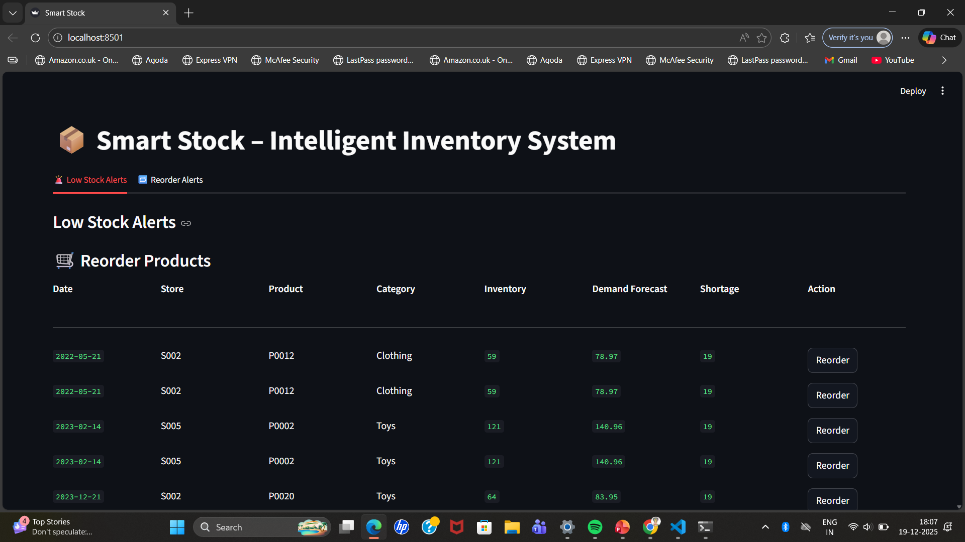

Slide 16
Supplier Management
Supplier Score Formula
Supplier Score = (rating × 0.5) + (discount × 0.3) − (lead time × 0.2)
Selection Flow
Get product category
Find suppliers linked to that category
Rank suppliers by score
Select top supplier automatically
Show top 3 suppliers for transparency

Slide 17
Automatic Reorder
Reorder Automation
When the user clicks Reorder
The system selects the best supplier
Inserts a new record into purchase_orders
Updates order status to ORDERED
Confirms the action in UI

Slide 18
